Slide 1
Modifying MASTML Workflows
Aiden Tepper
Informatics Skunkworks (MSE 299), 2 Credits
03-25-2021

Slide 2
Hours Summary
Date | Hours | Description of Work
3/24 | 2 | First half of module work
3/25 | 3 | Second half of module work and slide deck

Slide 3
Progress
The task assigned to us this week was to work through the “Modifying MASTML Workflows” module
This document walked us through creating, training, optimizing, and testing a ML model on Google Colab software using and manipulating sample data given to us, then gave us the space to modify a workflow with another model type
The best way to represent results from this week’s tasks is through either the output from running the MAST-ML code on the website or through the histograms/parity plots/other data found in the output files of the numerous MAST-ML runs

Slide 4
Problems
I didn’t encounter any major issues while working with Google Colab or the MAST-ML library
I struggled a little to understand exactly what was going on during certain steps, but paying closer attention to the details of the instructions document helped me work through the procedure while maintaining a grasp of what was going on behind the scenes
I also had a little difficulty understanding and applying the information I found on my chosen model type in the documentation

Slide 5
Questions
The only questions I really have from this week have to do with the MAST-ML library itself
I don’t fully understand what the Lasso model type entails (the model type I chose to modify my workflow with) and would love to explore that
There are also lots of files within the MAST-ML runs that I don’t understand the point of

Slide 6
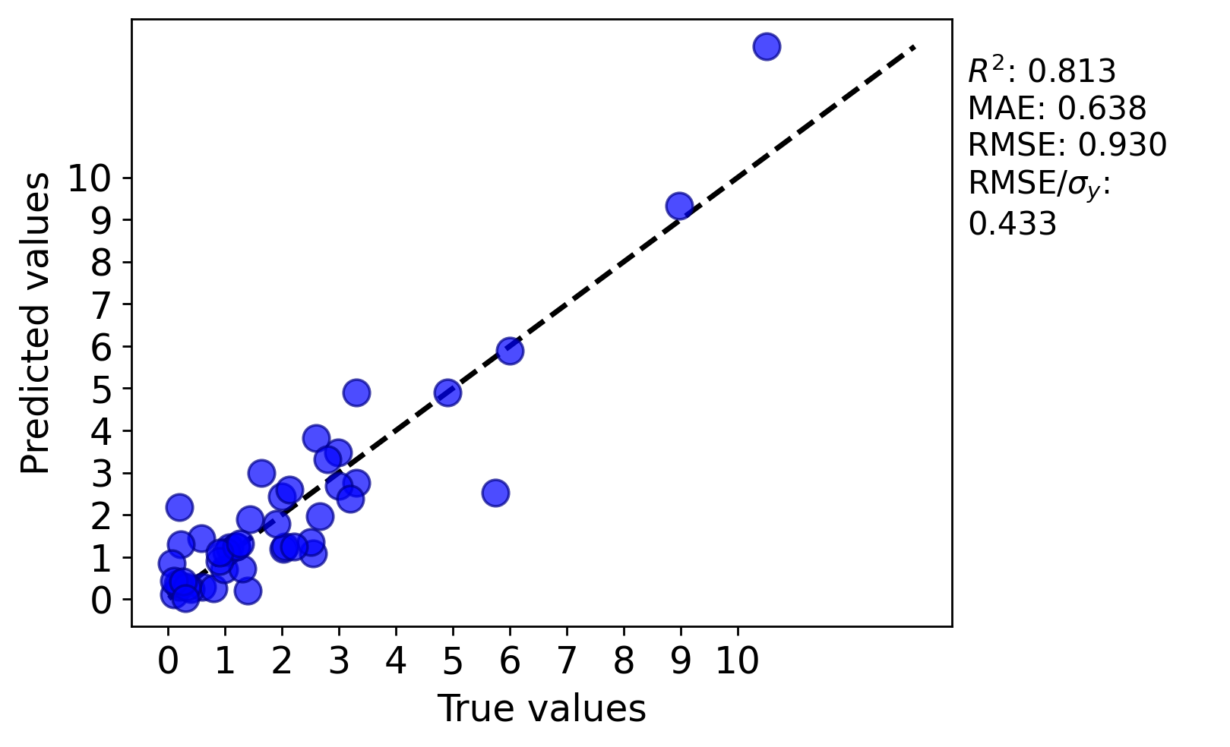
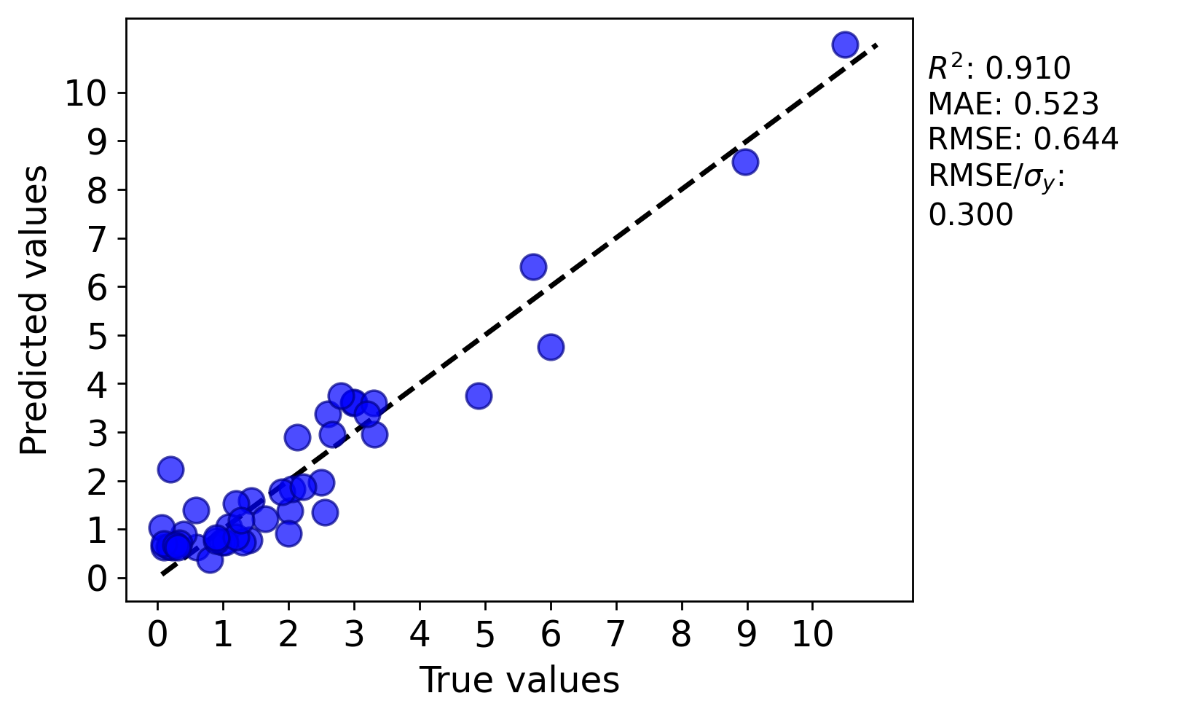
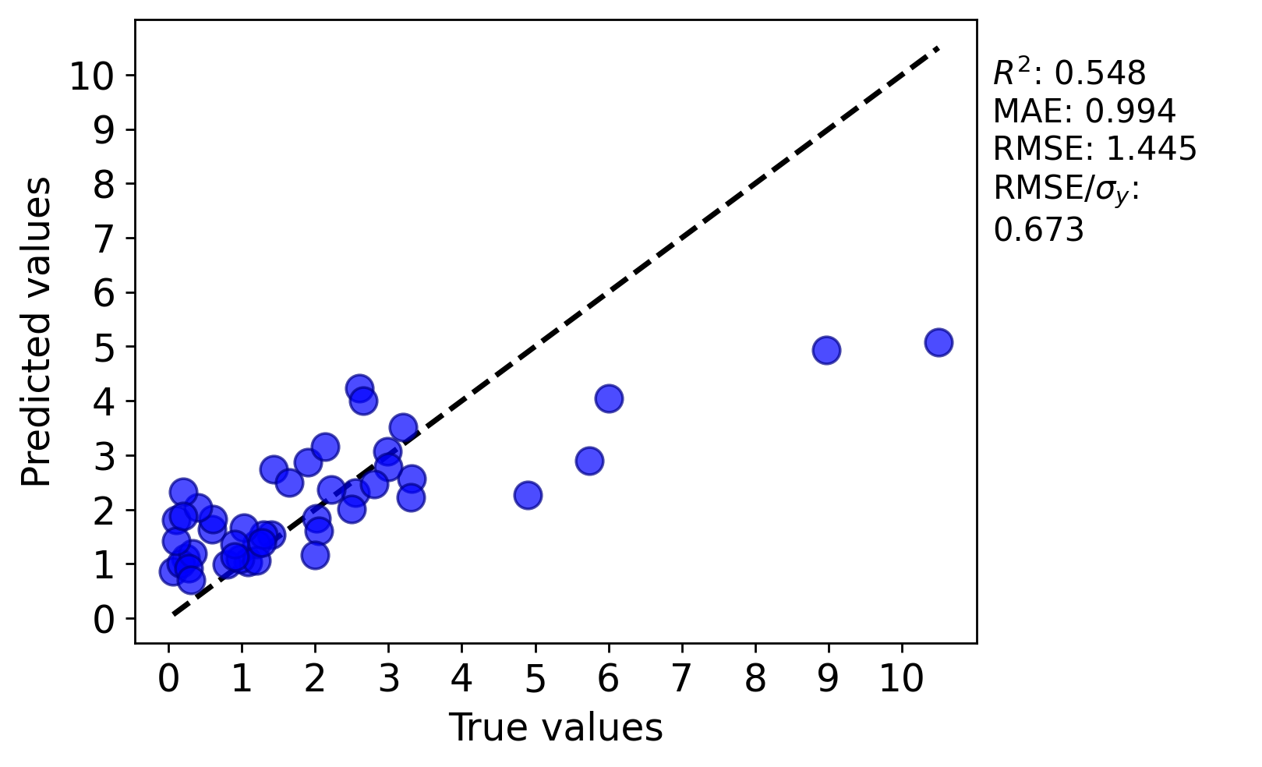
Assessment Figures

